Slide 1

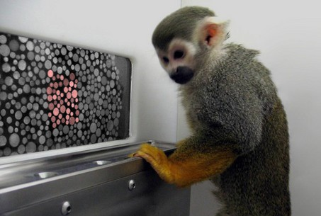
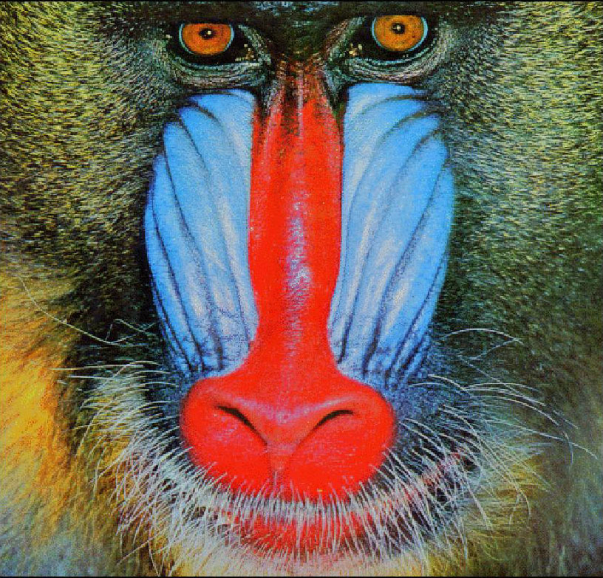
Teaching Workshop:
Color Vision in Primates and Other Mammals
Carrie C. Veilleux & Amber Heard-Booth
Anthropology Department, University of Texas at Austin

Slide 2
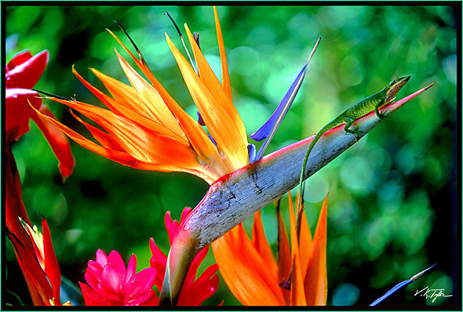

Trichromatic Color Vision
Notes:
Most people see the world in a variety of colors

Slide 3
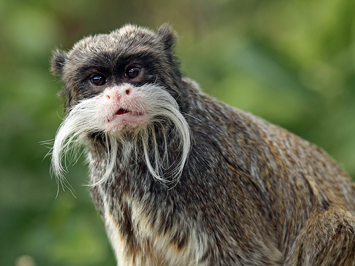
Trichromatic Color Vision
Notes:
Many monkeys and other primates, like us, also see the world in a variety of colors. Our type of color vision is known as trichromatic color vision. This means that we have 3 types of color-detecting cells in the retinas of our eyes.

Slide 4
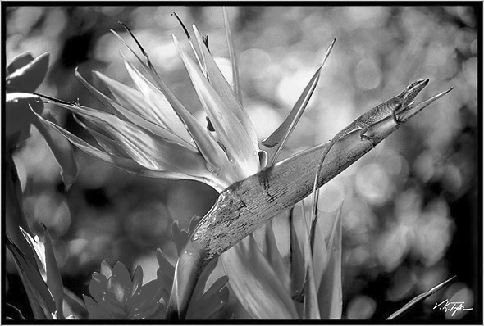

Notes:
How many of you have heard that dogs are color blind and only see the world in black and white?

Slide 5
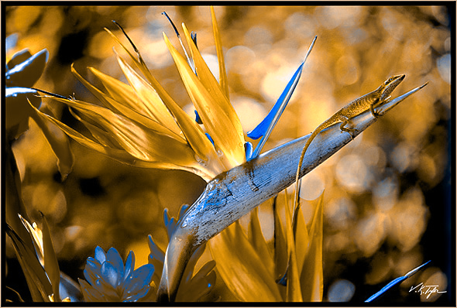
Dichromatic Color Vision
Notes:
In fact, dogs and most mammals, like cats, horses, cows, and deer have what is called dichromatic color vision, which is a type of color vision that allows these animals to discriminate blues and purples apart from yellows and greens, like in this picture. However, unlike us trichromats, dogs, cats, and most mammals can’t tell reds and greens apart.
So rather than being colorblind, these mammals do have some degree of color discrimination.

Slide 6



Trichromat
Dichromat
http://www.colblindor.com/coblis-color-blindness-simulator/
Notes:
Being a dichromat does make the holiday season a little less festive though!

Slide 7
How does this work?
Dichromats have 2 types of color-detecting cells in the retinas in their eyes:
Blue-sensitive cones
Yellow/green-sensitive cones
Notes:
So how does color vision work?
Well for dichromats, there are two types of color detecting cells in their eyes: blue cones that will fire a signal when they detect blue or violet colors and yellow/green cones that will fire a signal when they detect yellow, green, or red colors.

Slide 8

Dichromat
Green cone
-
Blue cone
Notes:
So when a dog looks at this image, his eye and his brain compare the responses of these two color-receptor types for the same point on the image and can tell if one is more blue or more yellow/green.

Slide 9
How does this work?
Trichromats have 3 types of color-detecting cells in the retinas in their eyes:
Blue-sensitive cones
Yellow/green-sensitive cones
Red-sensitive cones
Notes:
Trichromats instead have 3 types of color detecting cells, blue, yellow/green, and red-sensitive cones.

Slide 10
Dichromat
Trichromat
Green cone
Red cone
-
-
Green cone
Blue cone
-
Blue cone
Notes:
So a trichromat looking at this picture can compare both whether a part of the image is blue versus yellow/green, and whether it is green versus red. So trichromats have an extra channel for comparing colors.

Slide 11
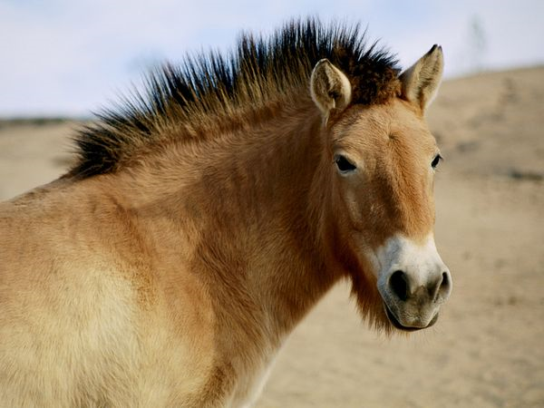
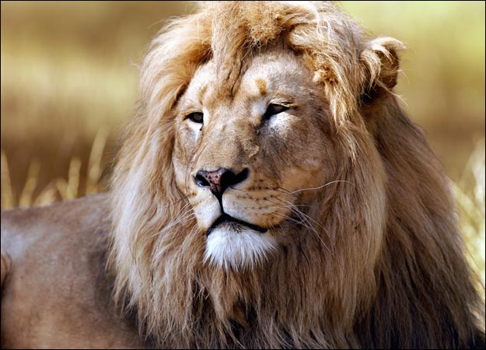

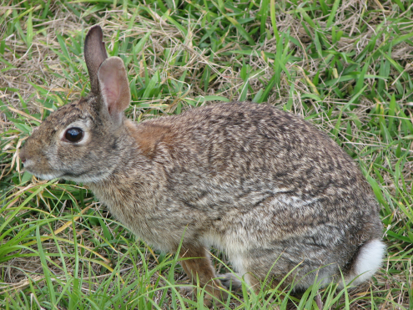
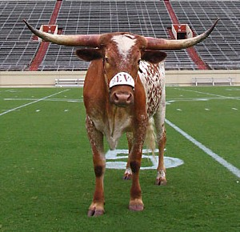
Most mammals are dichromats
Notes:
Most mammals are like dogs and cats– they are dichromats. So they’re not truly colorblind, instead they see the world as blues versus yellow/greens.

Slide 12

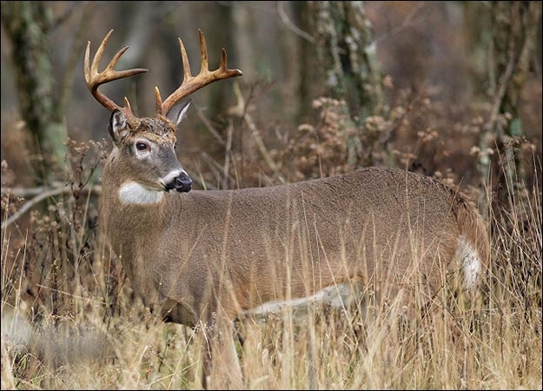
Notes:
This includes deer! So knowing that most mammals, like deer, are dichromats has a practical application! Wearing this orange reflective vest makes the hunter stand out from the green background for trichromats, but to a dichromat, the orange and the green are indistinguishable. So orange hunting clothes are a great safety tool when hunting mammals. They wouldn’t fool a bird though,

Slide 13
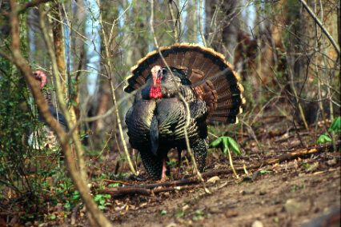
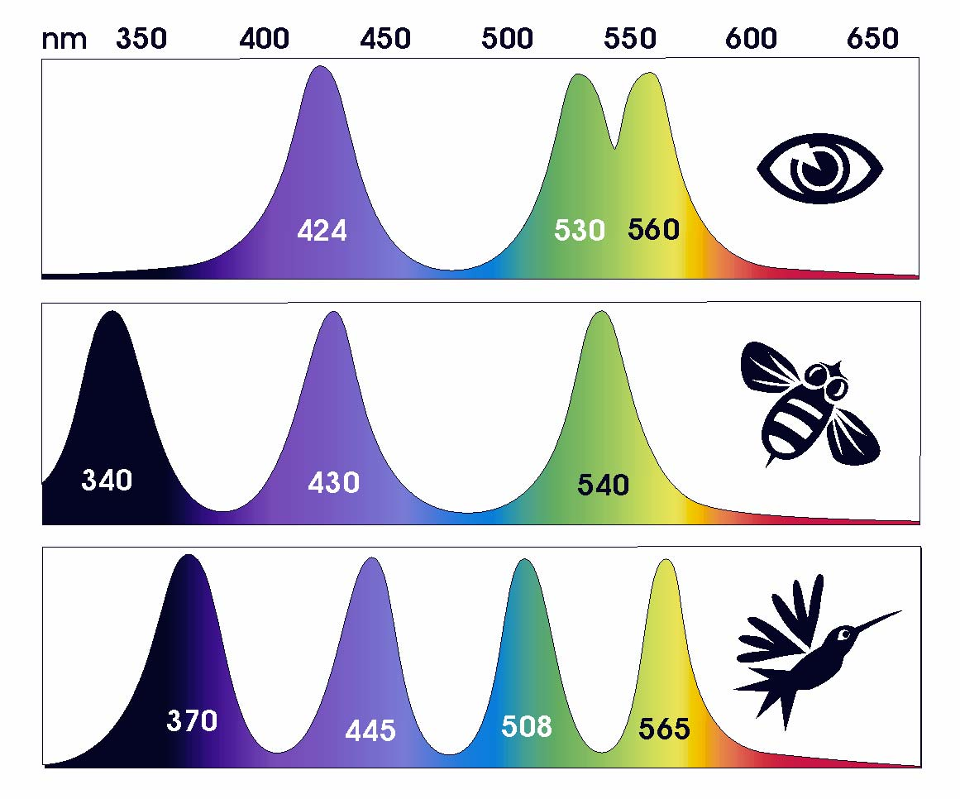
Notes:
Orange camo wouldn’t fool a turkey though—they have better color vision than we do, having 4 types of color-detecting visual cells.

Slide 14
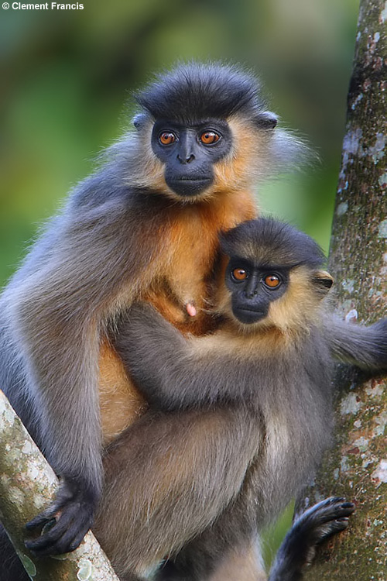
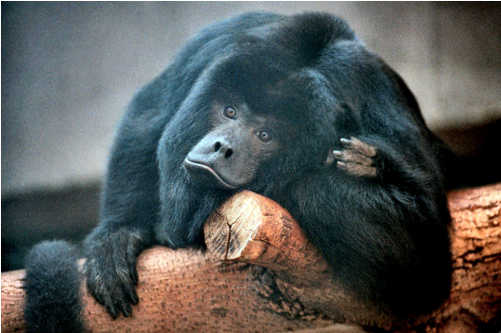
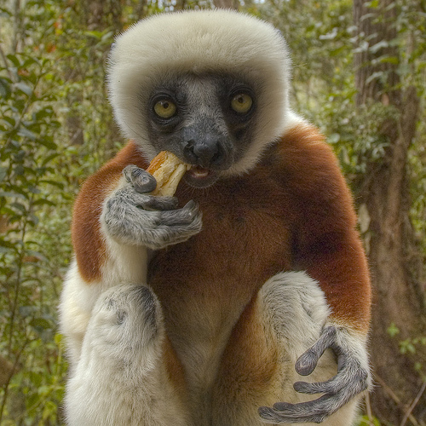
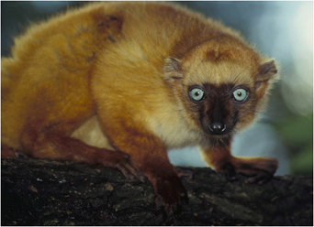
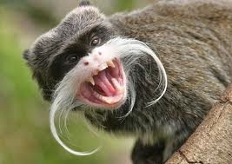
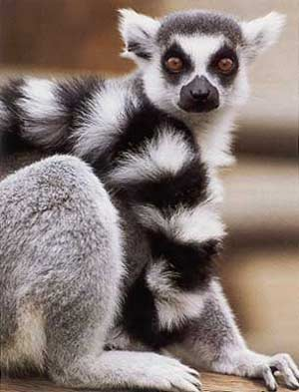
Many primates are trichromats
Notes:
So while not as good as birds, most primates have better color vision than other mammals in having trichromatic color vision. So we designed our activity around a big question in studies of the evolution of primate vision:

Slide 15
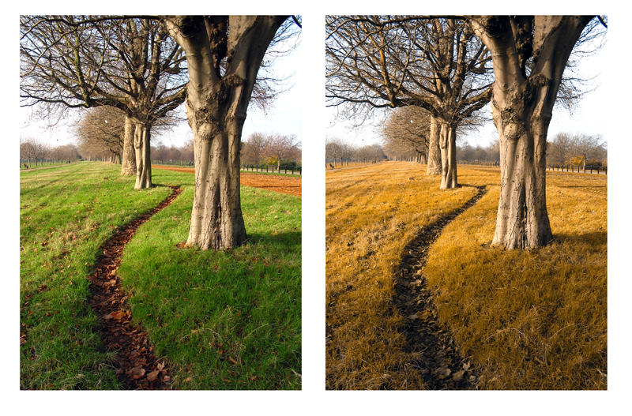
Activity: Why be a trichromat?
Notes:
Why be a trichromat?

Slide 16
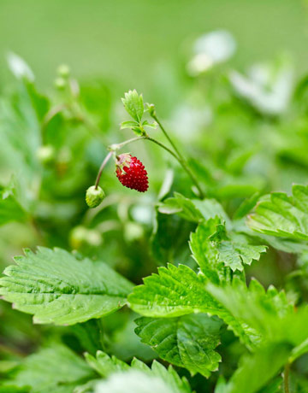
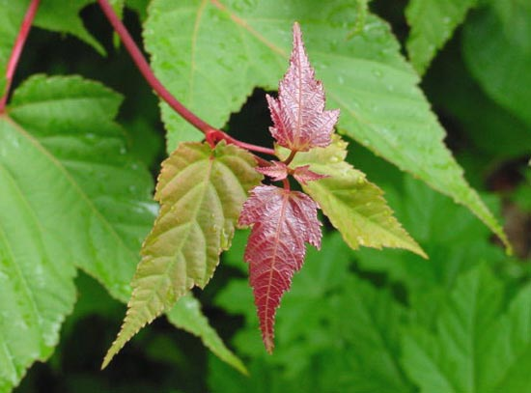
Activity: Why be a trichromat?
Hypothesis: Trichromacy is beneficial for detecting red food objects in a green leaf background.
Notes:
Primates eat a lot of fruit and young leaves, so being able to find the ripe fruit or the young leaves may be very important.

Slide 17
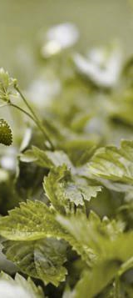
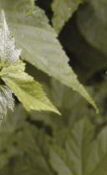
Activity: Why be a trichromat?
Hypothesis: Trichromacy is beneficial for detecting red food objects in a green leaf background.
Notes:
Because they can’t discriminate red from green, dichromats should have a harder time finding these ripe fruits or young red leaves.

Slide 18
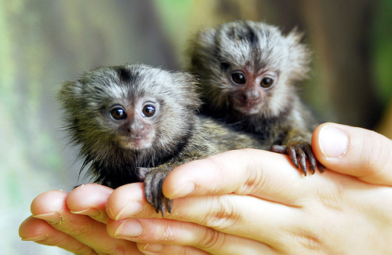
Activity: Why be a trichromat?
Based on an experiment done in marmoset monkeys
Some individuals were dichromats, some individuals were trichromats
Monkeys foraged for orange or green Kix cereal in green wood shavings

Slide 19
Basic Activity
Before beginning the experiment, students determine their color vision type (trichromat or dichromat)
IMPORTANT:
Up to 10% of men are red-green colorblind and so have dichromatic color vision.
Notes:
So before beginning experiment, students can determine their own color vision type, whether they are trichromats or dichromats. Red-green color blindness is related to defects on the X chromosome in the opsin genes, so up to 10% of men can be red-green colorblind.
This means that you will likely encounter colorblind students that may or may not know they’re colorblind. In a second we’ll mention some neat things that you can stress that makes these dichromatic students special.

Slide 20
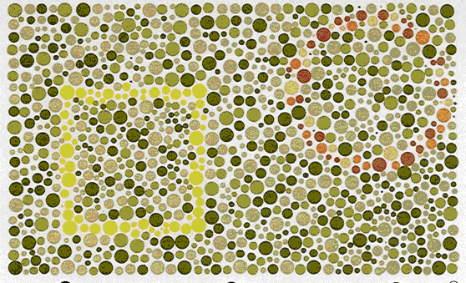
Dichromats see a square
Trichromats see a square and a circle
Notes:
So there are several tests of color vision type, but this one is easy– dichromats see the square, trichromats see a square and a circle. Does anyone think they’re a dichromat?

Slide 21
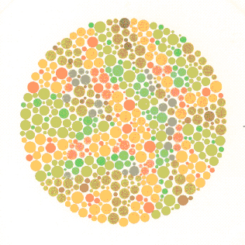
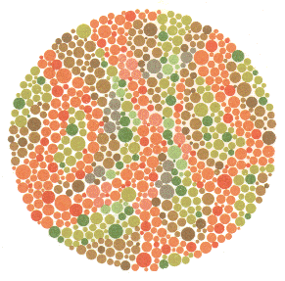
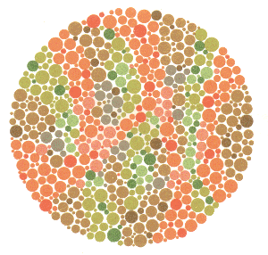
Dichromatic people and animals can actually detect camouflaged objects better than trichromats!
73
5
45
Notes:
So

Slide 22
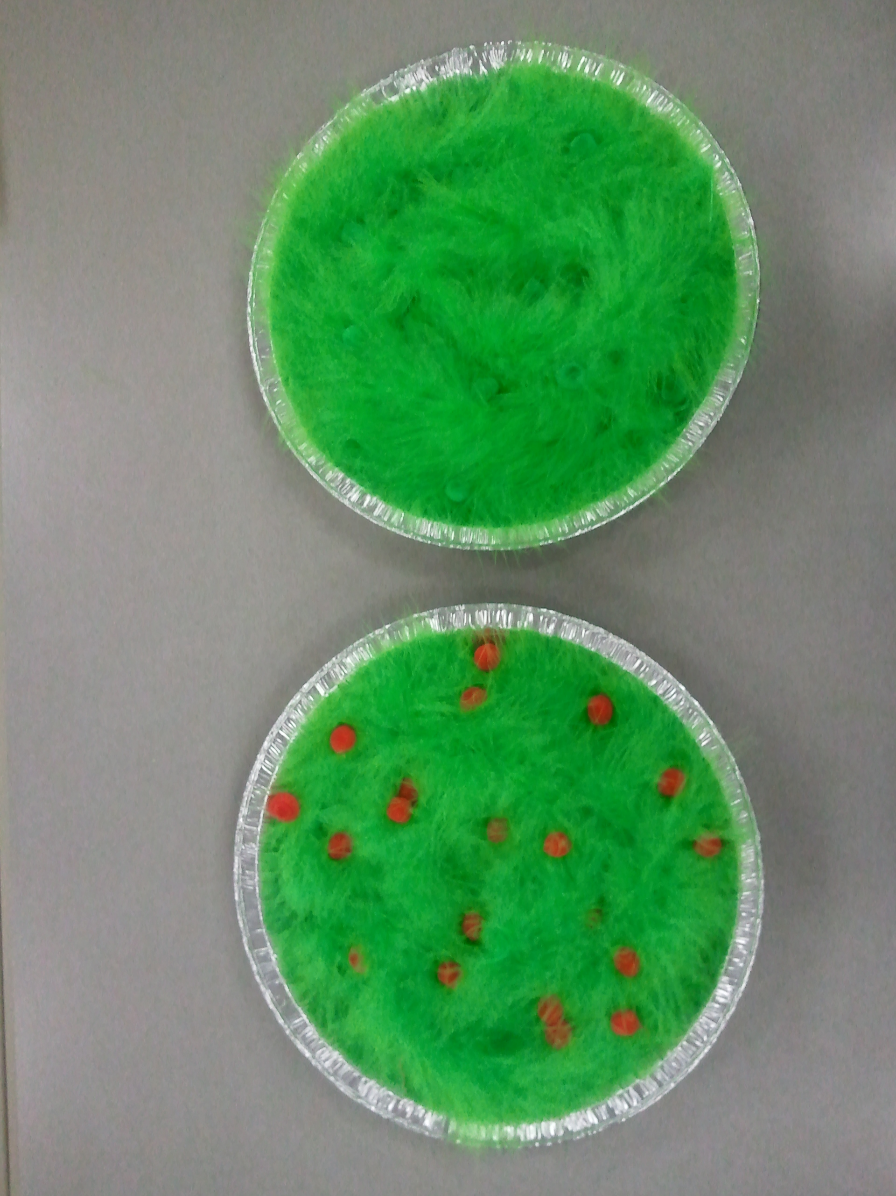
Basic Activity
Experiment has 2 parts:
  #1: Forage for green pompoms in green foliage
  #2: Forage for red pompoms in green foliage

Slide 23
Basic Activity
Goals:
Identify possible benefits of having trichromatic color vision for primates.
Identify benefits of having dichromatic color vision.
Explore the effects of red-green colorblindness in humans
Handouts offer several ways this activity can be adapted for different grade levels. Handouts and slides are available online at:
http://www.carriecveilleux.com/teaching

Slide 24
